Slide 1
Personal Finance Management App
Ashvitha
Dharshini
Dhinisha
Dhanalakshmi

Slide 2
Introduction to Personal Finance Management
Tittle:
Why Personal Finance Management Matters
Content:
Briefly explain the importance of managing personal finances.
Discuss challenges people face with budgeting, saving, investing, and tracking expenses.
Introduce the Personal Finance Management App as the solution to these challenges.

Slide 3
Key Features of the App
Budget Tracking
Expense Categorization
Expense Insights & Reports
Bill Reminders & Alerts
Goal Setting & Savings Planner
Debt Tracking & Management
Investment Monitoring
Multi-Account Integration
Security & Privacy
Financial Education & Tips

Slide 4
Budget Tracking :
Ability to create custom budgets for different categories (e.g., groceries, rent, entertainment).
Set monthly or weekly spending limits.
Real-time tracking of budget vs actual spending.
Expense Categorization :
Automatically categorizes transactions (e.g., food, transport, utilities).
Visual representation of expenses through charts and graphs.
Helps users identify spending patterns and areas for improvement.

Slide 5
Goal Setting & Savings Planner :
Set short-term and long-term financial goals (e.g., saving for a vacation, retirement).
Track progress and make adjustments to reach goals faster.
Visualize goals through progress bars or graphs.
Security & Privacy :
High-level encryption and multi-factor authentication (MFA) to protect user data.
Privacy controls to ensure that personal financial data remains confidential.
Commitment to maintaining secure and trustworthy service.

Slide 6
Benefits of the App :
Stay organized and in control of your finances.
Improve savings habits and track financial goals.
Eliminate late fees and avoid unnecessary debt.
Gain insights into spending behavior for smarter financial decisions.
Pricing Plans (If Applicable) :
Offer details about free trials, premium features, or subscription pricing (if applicable).
Highlight the value users receive for their investment.

Slide 7
MainActivity.kt
package com.example.pageapp
import android.os.Bundle
import androidx.activity.ComponentActivity
import androidx.activity.compose.setContent
import androidx.compose.foundation.layout.fillMaxSize
import androidx.compose.material3.MaterialTheme
import androidx.compose.material3.Surface
import androidx.compose.material3.Text
import androidx.compose.runtime.Composable
import androidx.compose.ui.Modifier
import androidx.compose.ui.tooling.preview.Preview
import com.example.pageapp.ui.theme.PageAppTheme
class MainActivity : ComponentActivity() {
override fun onCreate(savedInstanceState: Bundle?) {
super.onCreate(savedInstanceState)
setContent
{

Slide 8
PageAppTheme {
// A surface container using the 'background' color from the theme
Surface(
modifier = Modifier.fillMaxSize(),
color = MaterialTheme.colorScheme.background
) {
Greeting("Android")
}
}
}
}
}
@Composable
fun Greeting(name: String, modifier: Modifier = Modifier) {
Text(
text = "Hello $name!",
modifier = modifier
)
}

Slide 9
@Preview(showBackground = true)
@Composable
fun GreetingPreview() {
PageAppTheme {
Greeting("Android")
}
}

Slide 10
App.xml
<xml>
<navigation type="tabs" backgroundColor="" backgroundImage="" contentOverlap="" itemsPosition="" textStyle="" textSize="" textFont="" iosStyleNavigation="">
<items>
<item icon="" text="Home" textColor="" selectedTextColor="" selectedIcon="" backgroundImage="" selectedBackgroundImage="" backgroundColor="" selectedBackgroundColor="" />
<item icon="" text="Menu" textColor="" selectedTextColor="" selectedIcon="" backgroundImage="" selectedBackgroundImage="" backgroundColor="" selectedBackgroundColor="" />
<item icon="" text="Calculator" textColor="" selectedTextColor="" selectedIcon="" backgroundImage="" selectedBackgroundImage="" backgroundColor="" selectedBackgroundColor="" />
<item icon="" text="Share" textColor="" selectedTextColor="" selectedIcon="" backgroundImage="" selectedBackgroundImage="" backgroundColor="" selectedBackgroundColor="" />
</items>
</navigation>
<targetplatform simulator="Nexus5">Android</targetplatform>
<template price="199.99" id="SpaceApp" scaleWebPagesToBaseResolution="true" isUniversalApp="false" topadtype="none" bottomadtype="admob" globalLogo="" />
<prop id="appname" title="App Name">FinancialManagement</prop>

Slide 11
<prop id="tab1text" title="Tab1 Text">tab1</prop>
<prop id="tab1icon" title="Tab1 Icon">cover.png</prop>
<prop id="tab2text" title="Tab2 Text">tab2</prop>
<prop id="tab2icon" title="Tab2 Icon">index.png</prop>
<prop id="tab3text" title="Tab3 Text">tab3</prop>
<prop id="tab3icon" title="Tab3 Icon">content.png</prop>
<prop id="tab4text" title="Tab4 Text">tab4</prop>
<prop id="tab4icon" title="Tab4 Icon">coffee.png</prop>
<planname>Basic</planname>
<file id="appStyles.xml" newsfile="yes">
</file>
<page id="tab1.html" type="html" transition="" slidepageid="none" slidetransition="" hasreviews="no" hassend="no" hasfields="no" topad="no" bottomad="no" topadtype="none" bottomadtype="admob" dynamicdata="false" jsonurl="" hasreviewhtmlkey="no" kind="html" title="" logo="" shownavbar="yes" zoomEnabled="false" loadWebUrlsInSameWebView="false" backgroundColor="" />
<page id="tab3.html" type="calc" kind="html" transition="" slidepageid="none"
slidetransition="" hasreviews="no" hassend="no" hasfields="no" topadtype="none" bottomadtype="admob" dynamicdata="false" jsonurl="" hidebottombaratpush="no" hasreviewhtmlkey="no" title="" logo="" shownavbar="yes" zoomEnabled="false" loadWebUrlsInSameWebView="false" backgroundColor="">
</page>
<page id="tab2.html" type="html" transition="" slidepageid="none" slidetransition="" hasreviews="no" hassend="no" hasfields="no" topad="no" bottomad="no" topadtype="none" bottomadtype="admob" dynamicdata="false" jsonurl="" hasreviewhtmlkey="no" kind="html" title="" logo="" shownavbar="yes"

Slide 12
zoomEnabled="false" loadWebUrlsInSameWebView="false" backgroundColor="" />
<page id="tab4.html" type="appshare" kind="html" transition="" slidepageid="none" slidetransition="" hasreviews="no" hassend="no" hasfields="false" topadtype="none" bottomadtype="admob" dynamicdata="false" jsonurl="" hidebottombaratpush="no" hasreviewhtmlkey="no" fbappid="" title="" logo="" shownavbar="yes" zoomEnabled="false" loadWebUrlsInSameWebView="false" backgroundColor="">
<appdescription>This app contains financial management handbook and guidelines. Download for free now!</appdescription>
<links>
<share_link>http://build.appsmillion.com/marketr.aspx?p=%2BFBV3DSpqP7eM%2FP5WldEbu30jYH%2F9F6OYCHbv6uKDX1ImjhqvyOX6MwK2hAy6VCJ</share_link>
<primarystore>https://play.google.com/store/apps/details?id=com.tototomato.financialmanagement</primarystore>
<iphone>
</iphone>
<ipad>
</ipad>
<android>https://play.google.com/store/apps/details?id=com.tototomato.financialmanagement</android>
<kindle>
</kindle>
</links>
</page>

Slide 13
<restrictedaccess>
<feature id="announcements" enabled="true" />
<feature id="calendar" enabled="true" />
<feature id="coupon" enabled="true" />
<feature id="geofences" enabled="true" />
<feature id="loyalty" enabled="true" />
<feature id="map" enabled="true" />
<feature id="productorder" enabled="true" />
<feature id="pushnotifications" enabled="true" />
<feature id="Booking" enabled="true" />
<feature id="pnTopicSubscription" enabled="true" />
<feature id="loginregister" enabled="true" />
</restrictedaccess>
<rateapp appleid="" rateatlaunch="no" rateatrelaunch="no" message="" cancelmessage="" remindmessage="" actionmessage="" />
<ads allowUsingAdvertisingId="false" />
<admobpublisher id="ca-app-pub-2715744860432773/1419791442" interstitialUnitId="ca-app-pub-2715744860432773/2174825134" />
<doubleclickpublisher unitId="" />
<pollfish apiKey="" padding="0" position="na" />
<revmobappid id="-" />
<airpush appId="" apiKey="" interstitialAdType="" />
<scads refreshRate="30" />
<googleanalyticsid id="" />

Slide 14
<localizablelanguage value="en" />
<paypalappid id="" />
<fbapp apikey="392048634524604" />
<androidAppLicensing enabled="false" publicKey="" />
<apkExpansionFiles enabled="false" />
<androidInAppBilling enabled="false" />
<android installLocation="auto" />
<pdftron licenseKey="" />
<webView bouncesEnabled="false" hideLoadingAnimation="false" externalSiteZoomEnabled="true" />
<sharepointclient url="" username="" password="" />
<appstorelink>
</appstorelink>
<googleMaps androidApiV2Key="" />
<baiduMaps baiduMapsApiKeyAndroid="" baiduMapsApiKeyiOS="" />
<webapp statusBarStyle="default" iconsStyle="precomposed" offlineModeEnabled="false" inAppLinks="false" />
<locationServices>
<inUseDescription>
</inUseDescription>
<alwaysDescription> </locationServices>
<inAppSettings />
<hostedresources>
</hostedresources>

Slide 15
<file id="effective_time_management_importantvsurgent.html" newsfile="yes" />
<file id="time_management_introduction.html" newsfile="yes" />
<file id="12_steps_time_management.html" newsfile="yes" />
<file id="10_strategies_to_time_management.html" newsfile="yes" />
<file id="Introduction_to_Financial_Management.html" newsfile="no" />
<page id="Introduction_to_Financial_Management.html" type="pdfreader" kind="native" transition="NONE" slidepageid="none" slidetransition="" hasreviews="no" hassend="no" hasfields="no" topadtype="inherited" bottomadtype="inherited" dynamicdata="false" jsonurl="" hidebottombaratpush="no" hasreviewhtmlkey="no" textDirection="ltr" title="" logo="" shownavbar="yes" interstitialadtype="admob" interstitialadview="fullscreen">
<pdffile>1-Introduction_to_Financial_Management.pdf</pdffile>
</page>
<page id="Financial_Management_An_Overview.html" type="pdfreader" kind="native" transition="NONE" slidepageid="none" slidetransition="" hasreviews="no" hassend="no" hasfields="no" topadtype="inherited" bottomadtype="inherited" dynamicdata="false" jsonurl="" hidebottombaratpush="no" hasreviewhtmlkey="no" textDirection="ltr" title="" logo="" shownavbar="yes" interstitialadtype="admob" interstitialadview="fullscreen">
<pdffile>2-Financial_Management_an_Overview.pdf</pdffile>
</page>
<page id="Financial_Management_Handbook.html" type="pdfreader" kind="native" transition="NONE" slidepageid="none" slidetransition="" hasreviews="no" hassend="no" hasfields="no" topadtype="inherited" bottomadtype="inherited" dynamicdata="false"

Slide 16
jsonurl="" hidebottombaratpush="no" hasreviewhtmlkey="no" textDirection="ltr" title="" logo="" shownavbar="yes" interstitialadtype="admob" interstitialadview="fullscreen">
<pdffile>3-Financial_management_handbook.pdf</pdffile>
</page>
<page id="Financial_Management_Guidelines.html" type="pdfreader" kind="native" transition="NONE" slidepageid="none" slidetransition="" hasreviews="no" hassend="no" hasfields="no" topadtype="inherited" bottomadtype="inherited" dynamicdata="false" jsonurl="" hidebottombaratpush="no" hasreviewhtmlkey="no" textDirection="ltr" title="" logo="" shownavbar="yes" interstitialadtype="admob" interstitialadview="fullscreen">
<pdffile>4-guidelines-financial-management.pdf</pdffile>
</page>
<rotationapp>true</rotationapp>
<androidC2DM enabled="false" altEnabled="false" />
<androidpermissions>
<permission name="android.permission.INTERNET" enabled="true" />
<permission name="android.permission.ACCESS_COARSE_LOCATION" enabled="false" />
<permission name="android.permission.ACCESS_FINE_LOCATION" enabled="false" />
<permission name="android.permission.WRITE_EXTERNAL_STORAGE" enabled="true" />
<permission name="android.permission.ACCESS_NETWORK_STATE" enabled="false" />
<permission name="android.permission.READ_PHONE_STATE" enabled="false" />
<permission name="android.permission.RECORD_AUDIO" enabled="false" />
<permission name="android.permission.CAMERA" enabled="false" />

Slide 17
</androidpermissions>
<androidversion>1.5</androidversion>
<androidversioncode>6</androidversioncode>
<androidbundlename>com.tototomato.financialmanagement</androidbundlename>
<androidshortappname>FinancialManagement</androidshortappname>
<syncenabled>true</syncenabled>
<file id="tab3.html" newsfile="no" />
<file id="tab4.html" newsfile="no" />
<file id="tab2.html" newsfile="no" />
<file id="tab1.html" newsfile="no" />
<dropboxapp dropboxapikey="" />
<healthKitServices>
<healthShareUsage>
</healthShareUsage>
<healthUpdateUsage>
</healthUpdateUsage>
</healthKitServices>
<cameraServices>
<cameraUsageDescription>
</cameraUsageDescription>
</cameraServices>
<photoLibraryServices>
<photoLibraryUsageDescription>
</photoLibraryUsageDescription>

Slide 18
</androidpermissions>
<androidversion>1.5</androidversion>
<androidversioncode>6</androidversioncode>
<androidbundlename>com.tototomato.financialmanagement</androidbundlename>
<androidshortappname>FinancialManagement</androidshortappname>
<syncenabled>true</syncenabled>
<file id="tab3.html" newsfile="no" />
<file id="tab4.html" newsfile="no" />
<file id="tab2.html" newsfile="no" />
<file id="tab1.html" newsfile="no" />
<dropboxapp dropboxapikey="" />
<healthKitServices>
<healthShareUsage>
</healthShareUsage>
<healthUpdateUsage>
</healthUpdateUsage>
</healthKitServices>
<cameraServices>
<cameraUsageDescription>
</cameraUsageDescription>
</cameraServices>
<photoLibraryServices>
<photoLibraryUsageDescription>
</photoLibraryUsageDescription>

Slide 19
</photoLibraryServices>
<microphoneServices>
<microphoneUsageDescription>
</microphoneUsageDescription>
</microphoneServices>
<targetdevicesize>100</targetdevicesize>
</xml>

Slide 20
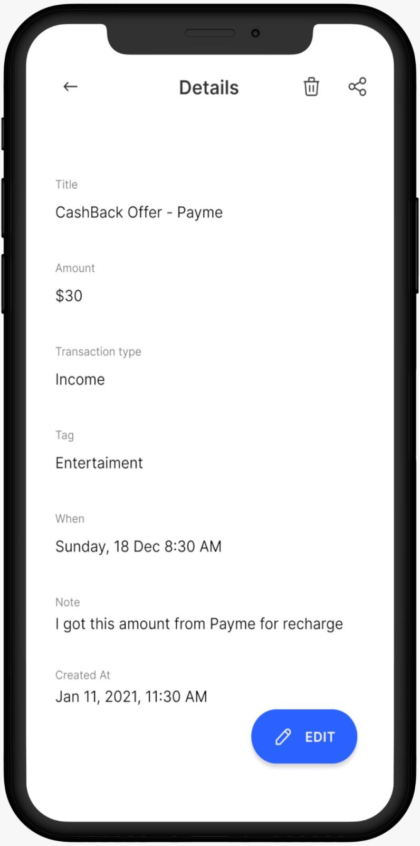
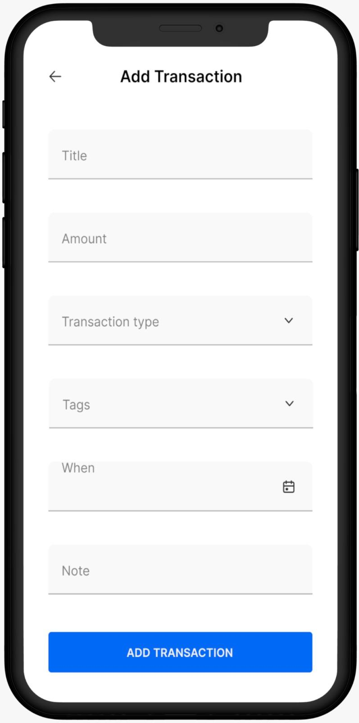
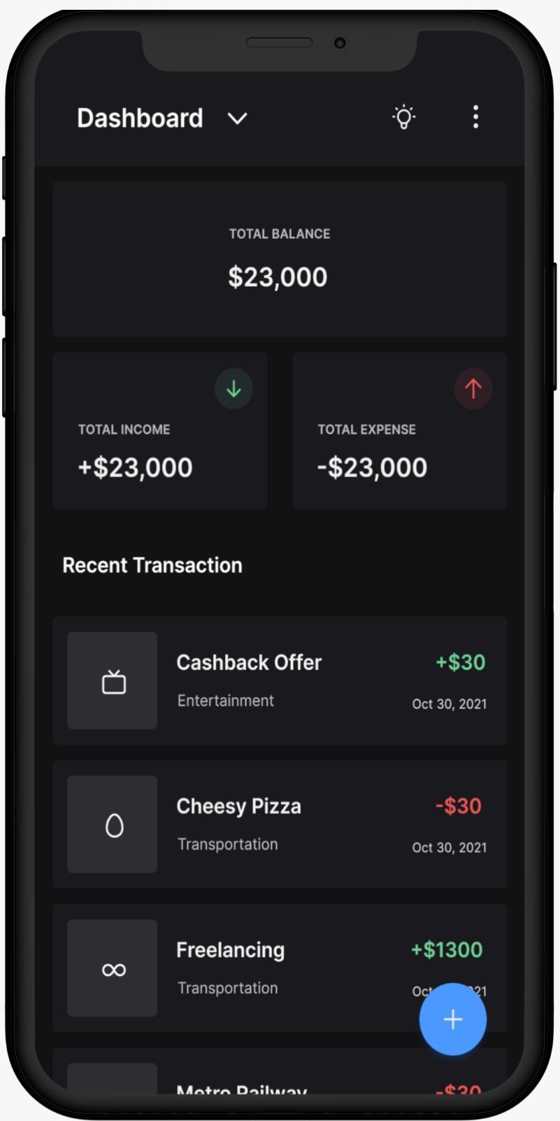
Output :

Slide 21
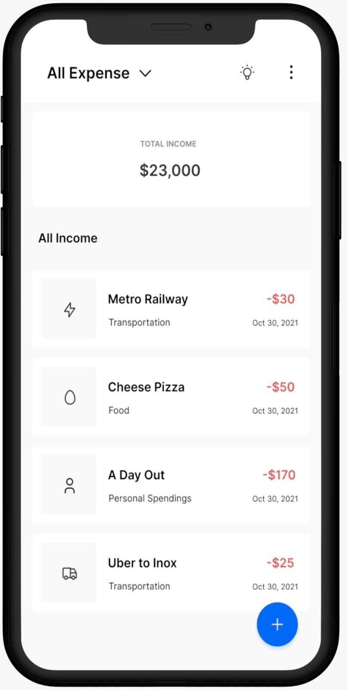
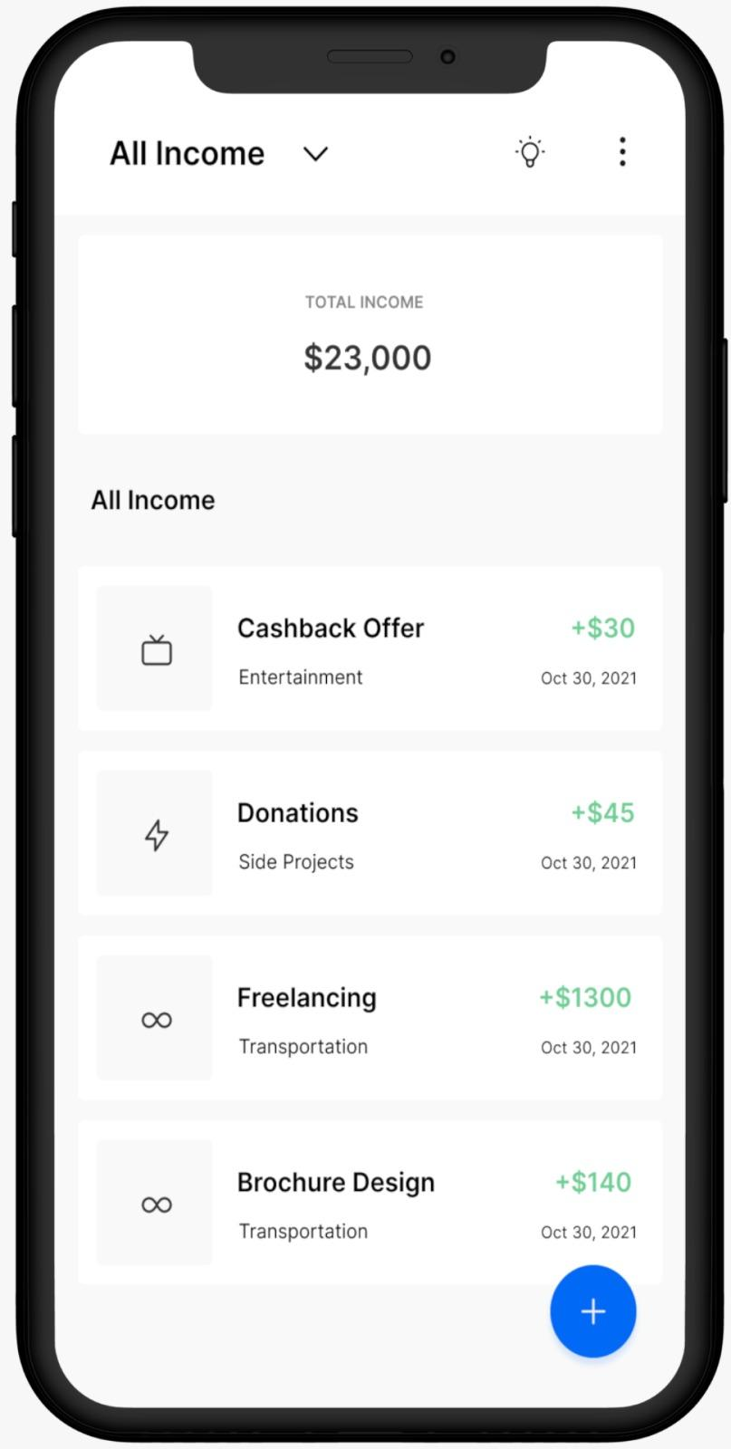

Slide 22
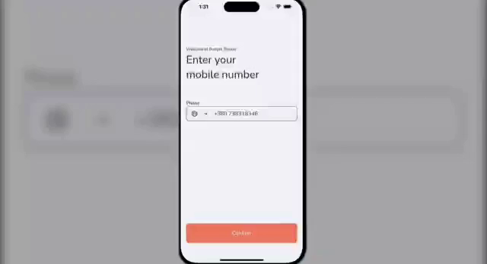
Demo Video :

Slide 23
Conclusion:
Our personal finance management app, built with Kotlin, empowers users to take control of their financial journey. With its intuitive design, seamless functionality, and advanced tools like budgeting, expense tracking, and financial insights, the app provides a comprehensive solution for managing personal finances effectively. By combining simplicity with robust performance, it serves as a reliable companion for anyone striving to achieve their financial goals and secure a stable financial future.

